Slide 1
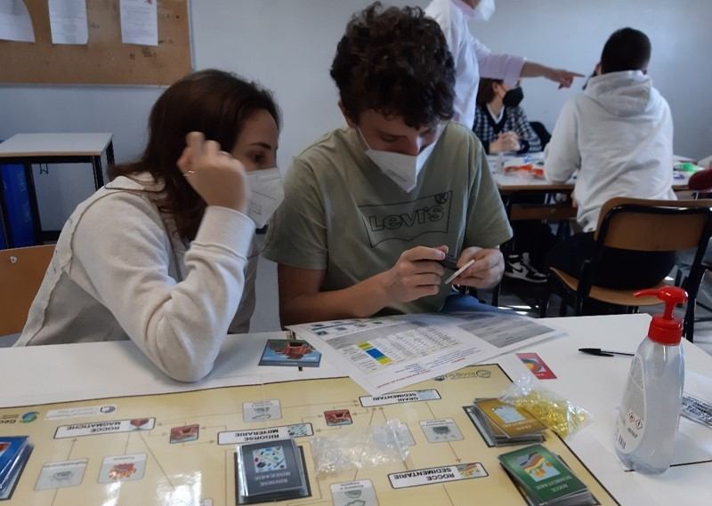
11th International Conference CCM, Zlatibor , 12 October 2023
How to trigger the youngsters' interest in the raw material sector and improving public acceptance:
the role of education
Armida Torreggiani
Senior Research CNR
armida.torreggiani@isof.cnr.it

Slide 2
Raw Materials Industry & Public Acceptance
Our life is dependent on mining
Accessible raw materials are essential in technology and allow the transition towards a low-carbon economy

Slide 3
Raw Materials Industry & Public Acceptance
Low Public acceptance of Mining activities in the EU
Mining industry needs the acceptance of the society in order to avoid conflicts
The Raw Materials Industry must ensure that society knows and has awareness of the benefits of the Metals and Minerals sector.
Notes:
The positive contribution of mining to everyday activities and to innovation and green technologies is often overlooked.

Slide 4
Understanding of the Importance of Mineral Resources &Public Acceptance
Any idea what your kids know about minerals and metals and their importance in our daily lives?
Notes:
Without an accurate understanding of the importance of mineral resources, as well as how and from where these resources are obtained, citizens cannot contribute to the well-being of Europe with regards to securing essential mineral resources in ethical and sustainable ways.

Slide 5
Raising Awareness and Knowledge
Objectives:
To bring minerals and mining closer to society;
All Citizens have a better understanding of the importance of metals and minerals for EU value chains and ecosystems;
Strength the relationship between RM industry and society through activities to link the industry with its surrounding community;
Notes:
Our objectives are:
To bring minerals and mining closer to society and increase the general knowledge about the importance of the European mining industry.
And last but not least, we would like to provide engaging online educational materials.

Slide 6
EDUCATION – KEY ROLE TO INCREASE UNDERSTANDING of Industrial Activities
Primary agent of societal transformation
Develops Critical Thinking --> make decisions more consciously
Notes:
We are very limited to addressing the general public and the educational project is one of our opportunities. Addressing kids and students means addressing their teachers and parents. We will appreciate your help in this challenging task.

Slide 7
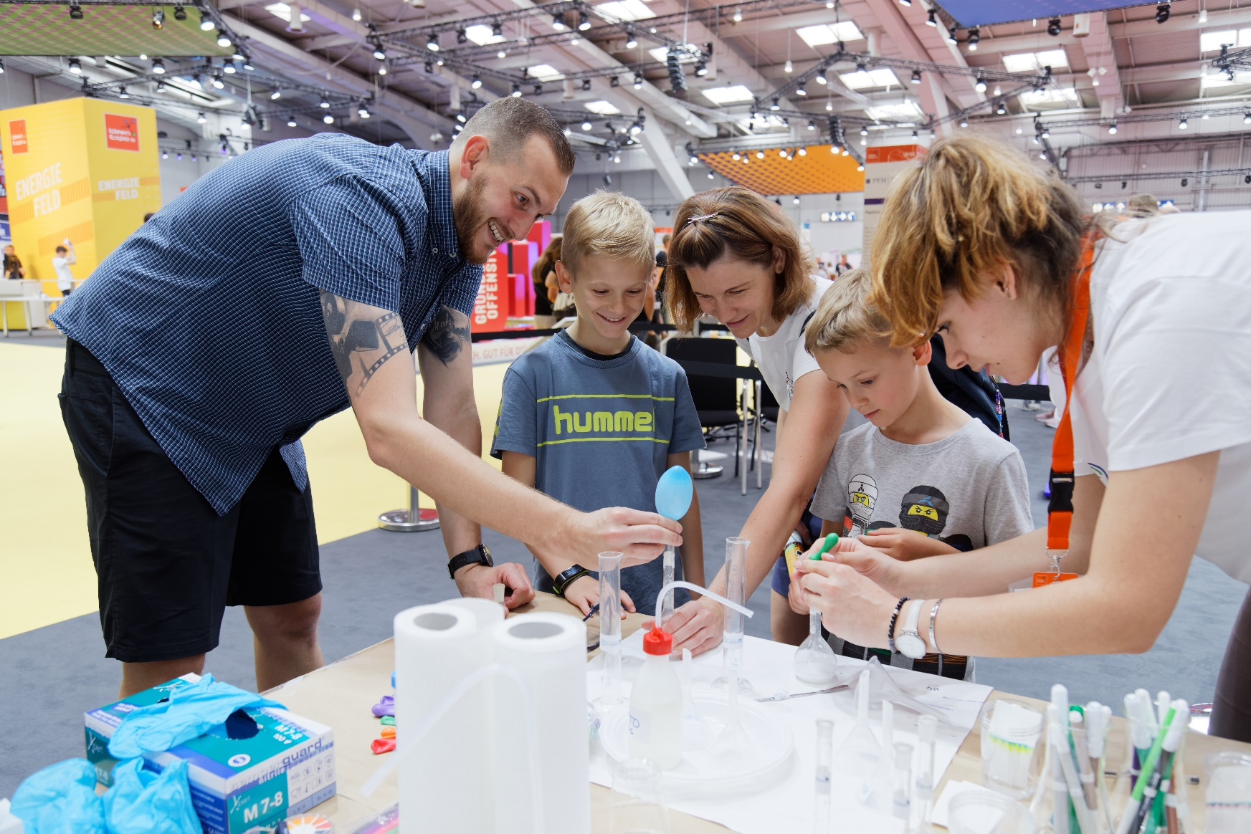
Addressing kids and students --> means addressing their families.

Slide 8
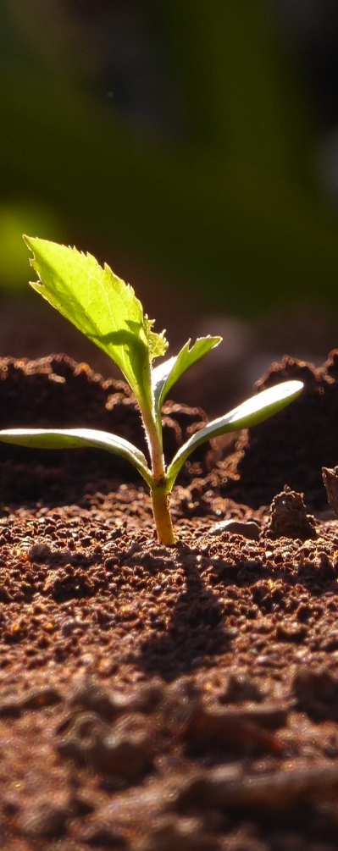
It is necessary to enhance the educational process
by providing educational materials and engaging experiences
Key Role of Schools
Video1

Slide 9
FROM Information to Engagement
I heard and I forget, I see and I remember, I do and I understand
Confucius

Slide 10
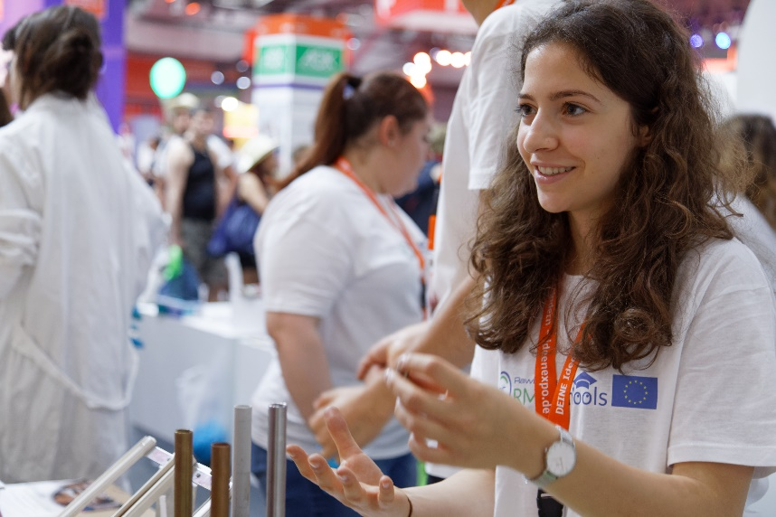
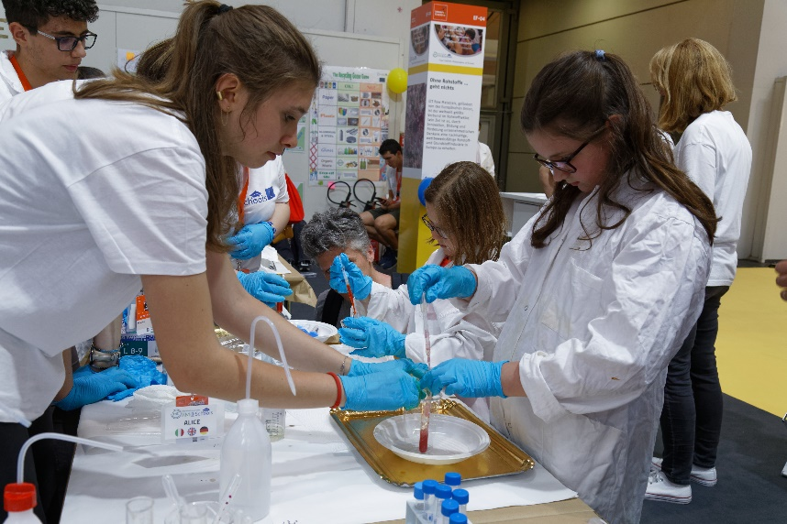
Raw MatTERS Ambassadors at Schools*
an innovative program to make science education and careers in RM attractive for youngsters, involving RM experts and teachers (RM Ambassadors).
http://rmschools.eu/
Coordinated by CNR (A. Torreggiani)
RM@Schools is the Flagship Program in the Wider Society Learning segment of EIT RawMaterials
*In our name, "Raw MatTERS”, our message resonates: raw materials are our key focus-Tackling European Resources Sustainably -TERS

Slide 11
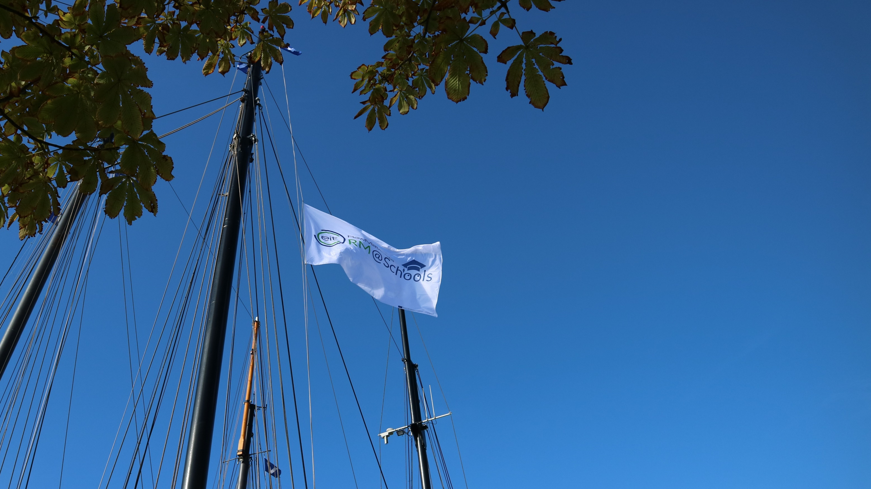
RM@Schools Network
30 PARTNERS
19 Countries
160 Schools
30 Companies
11 Museum
26 Univ. & Res. Institutes

Slide 12
RM@Schools
It is fostering a large range of actions towards society in order
to raise awareness of the importance of raw materials
2022
19
Countries
4800
Students
83
Events
22.000
General
public
2019
18
Countries
1600
Students
67
Events
14.000
General
public
2016
6
Countries
600
Students
1
Event
500
General public

Slide 13
Raw Matters Ambassadors at Schools
pupils from 10 to 18 yrs
Idea:
an active learning at school by involving students in experiments with RM-related hands-on educational kits and in communication activities
Lab experiments
Communication Activities

Slide 14
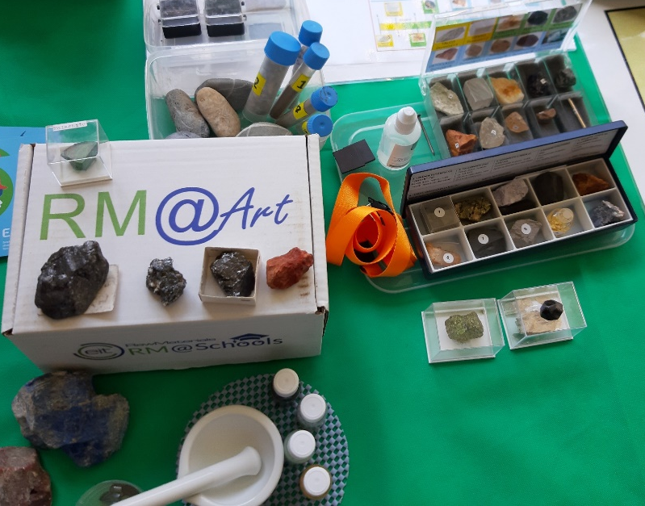
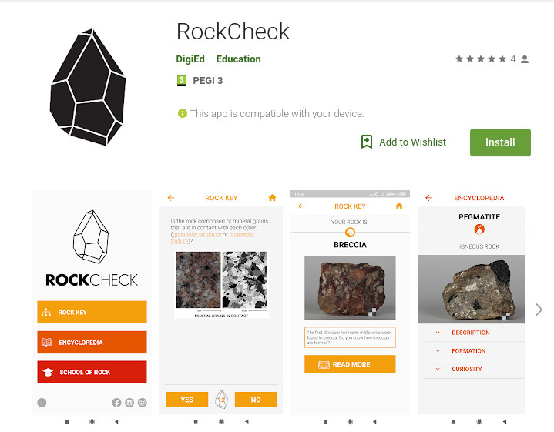
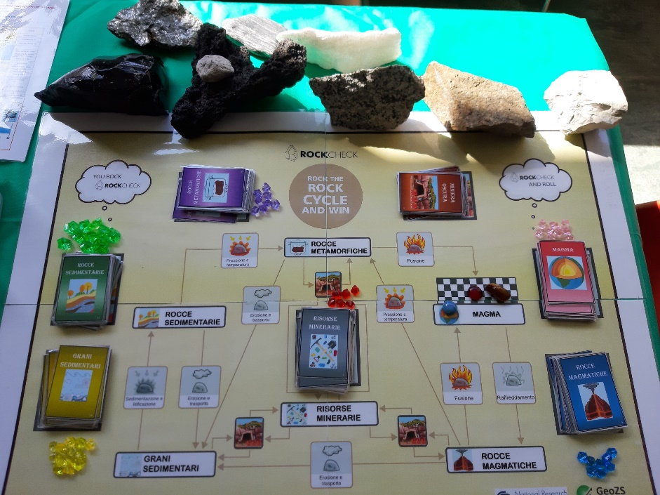
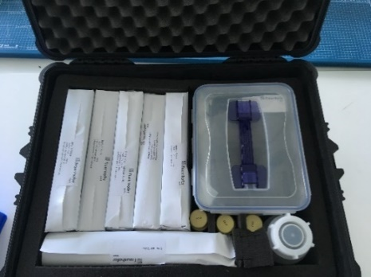
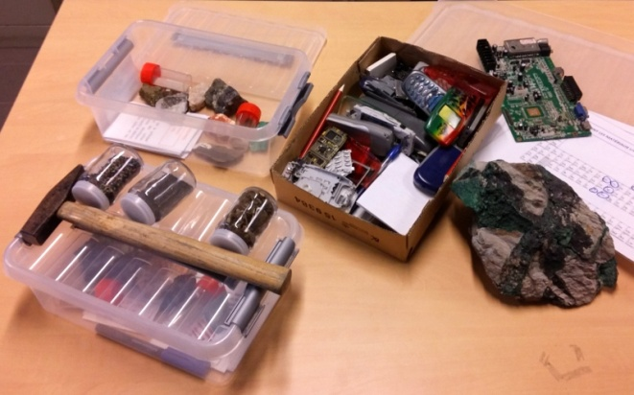
Active learning: Toolkits
Free available on the RM@Schools website
http://rmschools.eu/
App
Lab Kit
Educational games

Slide 15
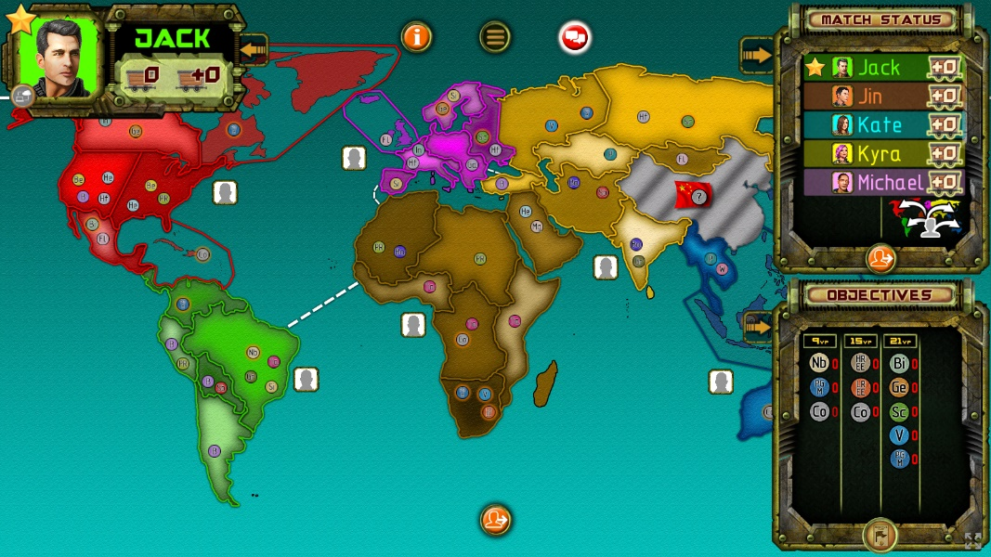
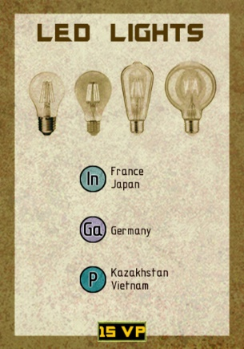
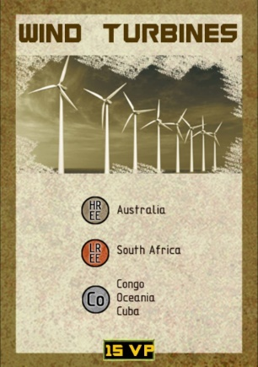
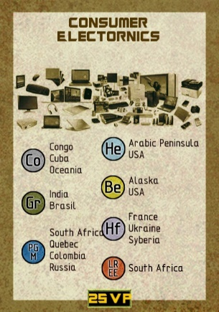
To learn and have fun…
Digital game
Set in a fantasy world where the main producer of Critical RMs completely closed its borders
the winner is determined according to who completed the devices in their own Device Card and scores the most points
Target: High Schools

Slide 16
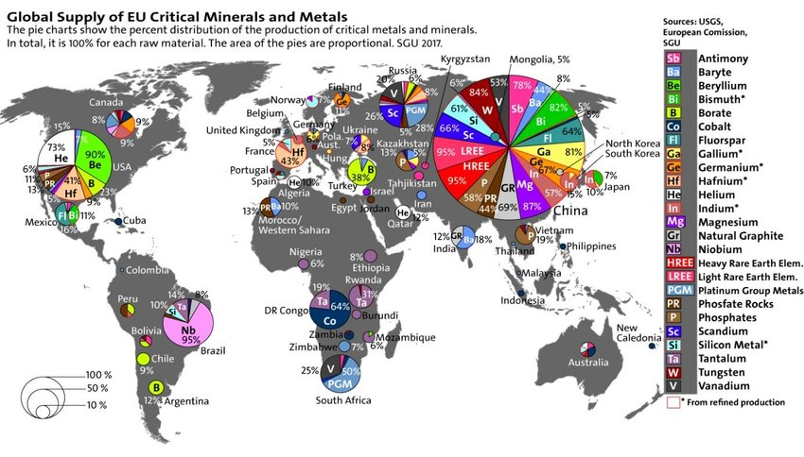
To learn and have fun…
Digital game
Set in a fantasy world where the main producer of Critical RMs completely closed its borders
Target: High Schools
Map realised by SGU

Slide 17
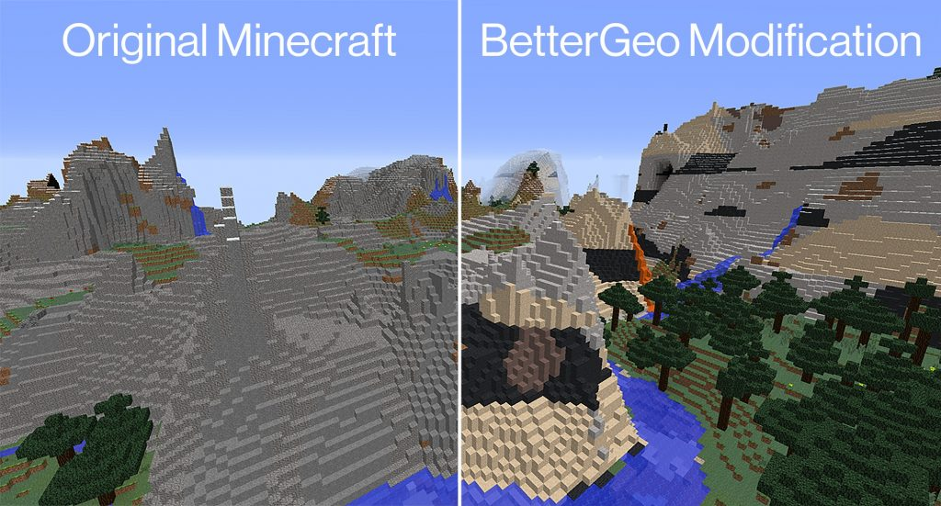
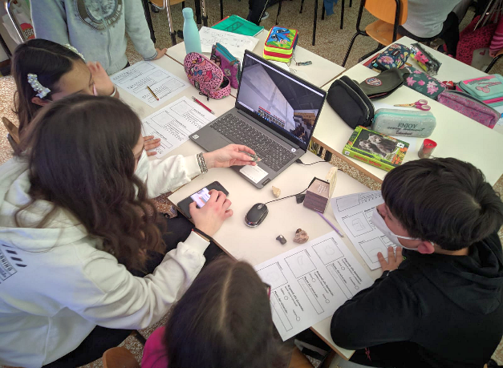
BetterGeo
Digital game
Rocks &
Minerals exercise
https://www.bettergeoedu.com/
Mining for metals and minerals allows the players to advance in technologies
Available in 6 languages
Target: Middle Schools

Slide 18
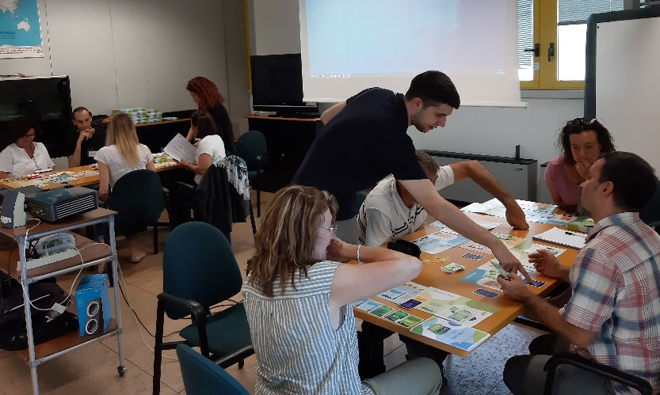
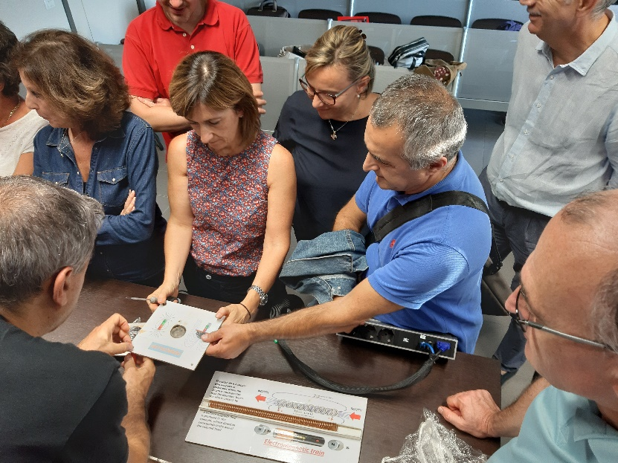
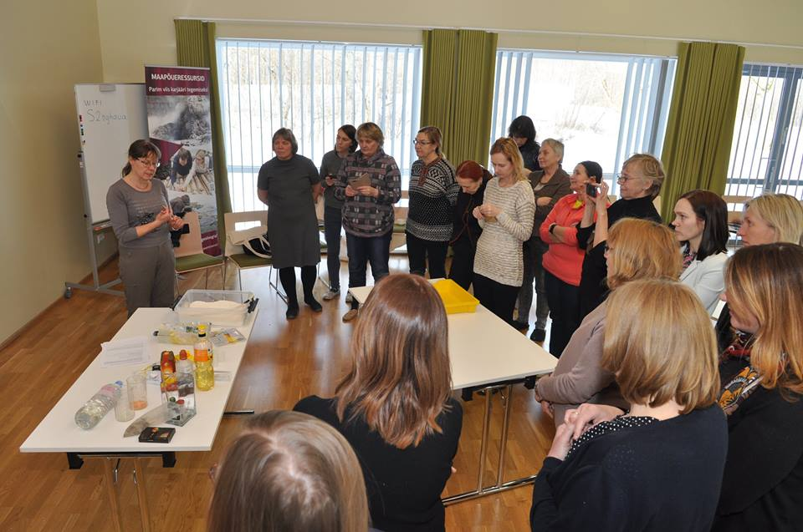
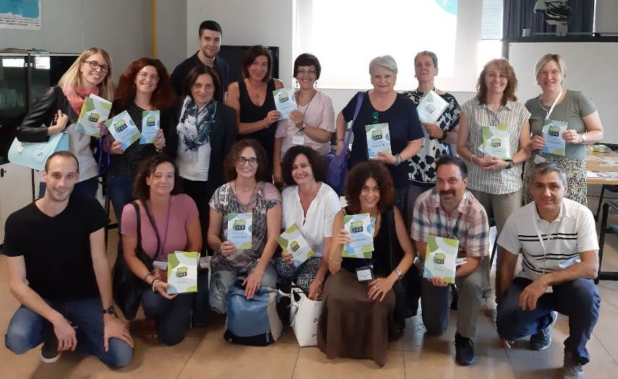
Train-the-Trainer Program
To promote the use of the new educational materials
ENGAGE/EMPOWER TEACHERS
Workshops for teachers
830 trained teachers in 3 years

Slide 19
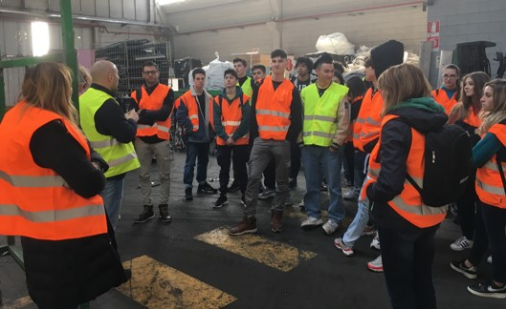
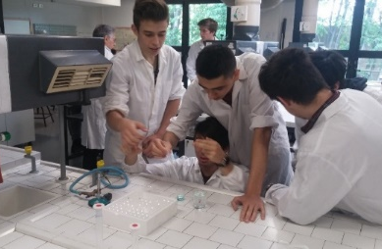
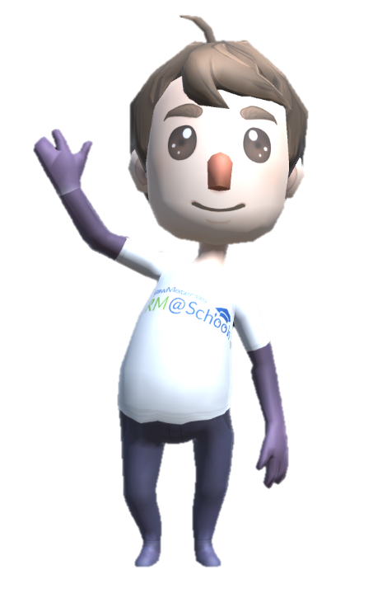
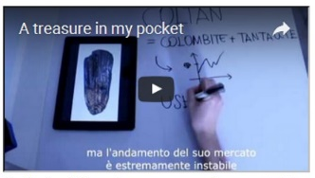
RM@Schools methodology: Learning pathways
All students are introduced into some RM-related topics by RM Ambassadors (experts from the Consortium & teachers)
Active role in Science Dissemination
Lab
experiments
Study-Visit
in
Company
Lessons
http://rmschools.eu

Slide 20
Students from Spain and Italy visit a German factory that recycles waste from electric and electronic equipments

Slide 21
2nd International Summer Camp
“Minerals without boarders”
Banja Luka (Bosnia-Herzegovina) August 29-September 2, 2023

Slide 22
Summer Camp “Minerals without boarders”
Banja Luka (Bosnia-Herzegovina)
Students from Italy, Hungary, Germany and Bosnia-Herzegovina visit a “green mine” of Lignite in the Republic of Srpska.

Slide 23
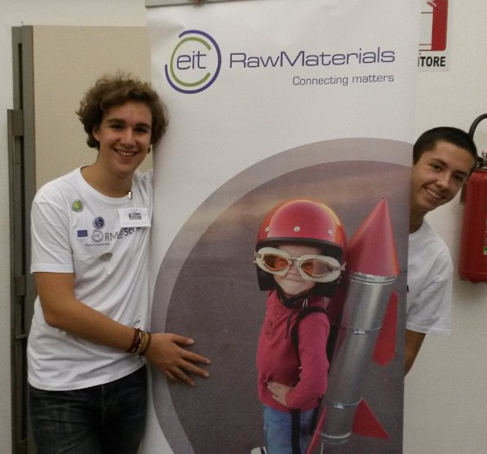
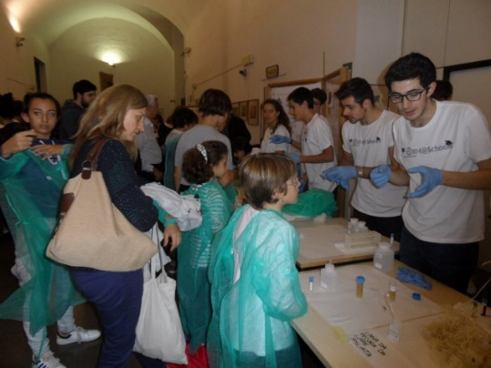
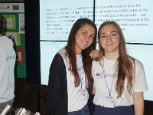
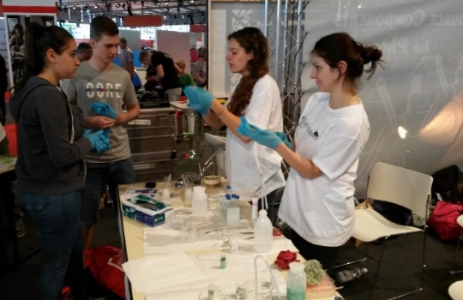
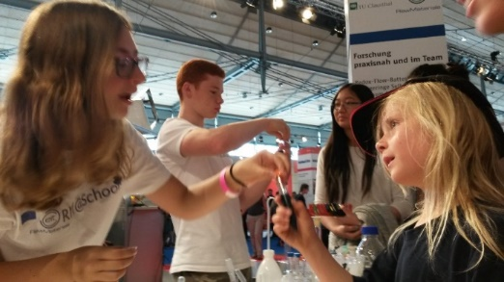
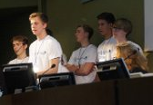
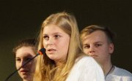
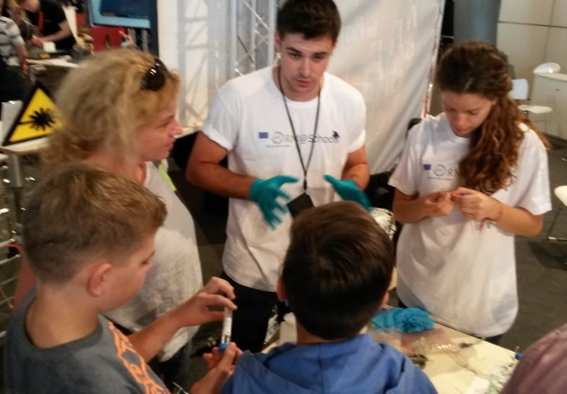
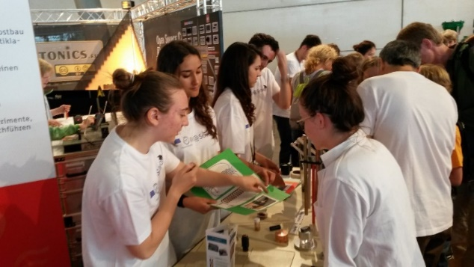
MULTIPLIERS of KNOWLEDGE

Slide 24
Young RM ambassadors ……in action
Active role in Science Dissemination
Students become
“Young RM Ambassadors“
by creating dissemination products focused on Raw Materials
https://rmschools.isof.cnr.it/students-in-action/
Experiments
Facebook Page
School Magazine
Comics
Website
Notes:
It is also crucial to create synergies, by linking other initiative, not only in the KIC but also cross-KIC.
This could be achieved by the consolidation of the existing portfolio, which means
Mapping other initiatives with similar interests
Build a network of WSL-interested people in the partners organisations
But also by
Create a tool-box including available resource e.g. schools, museums etc., to enhance the network
promote M&N events (brokerage and dissemination events, as science festivals, exhibitions, etc.)

Slide 25
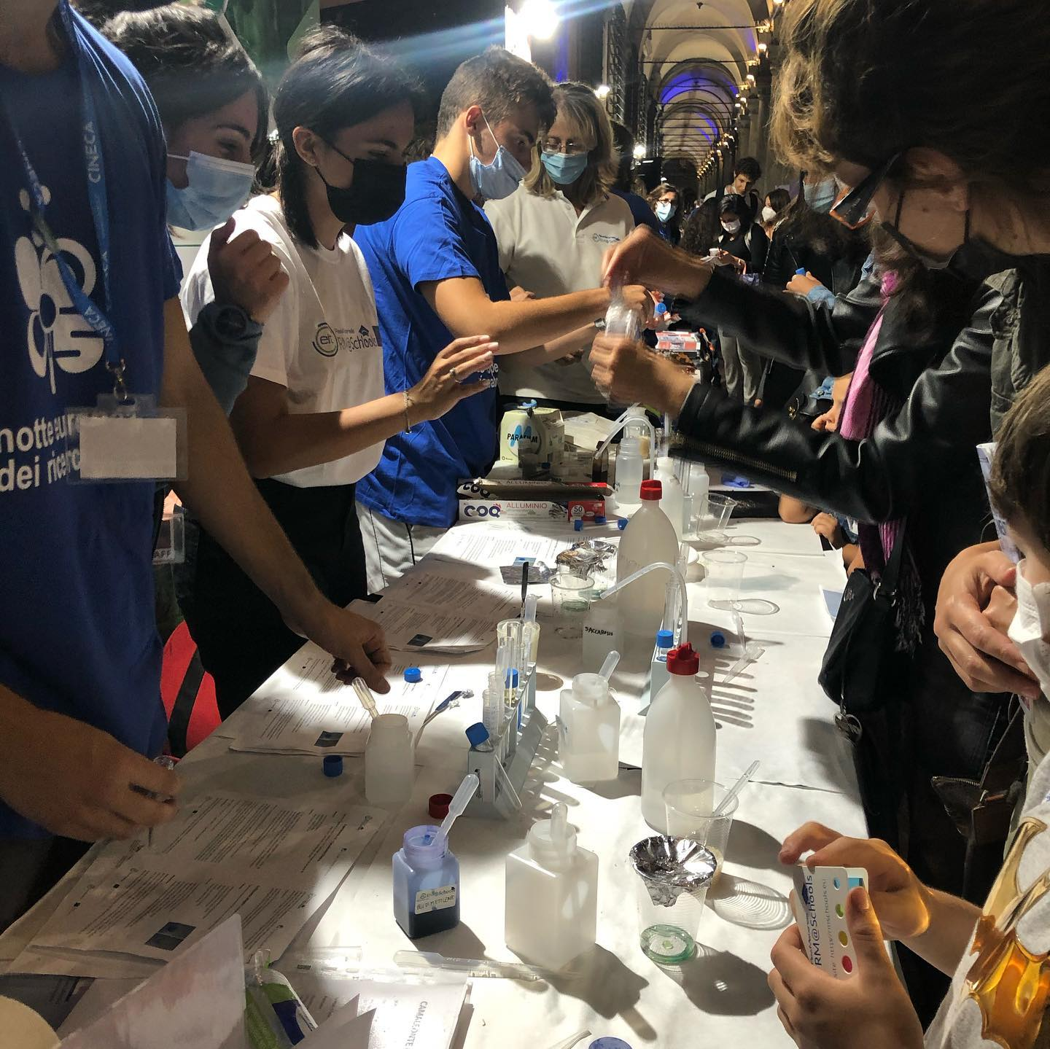
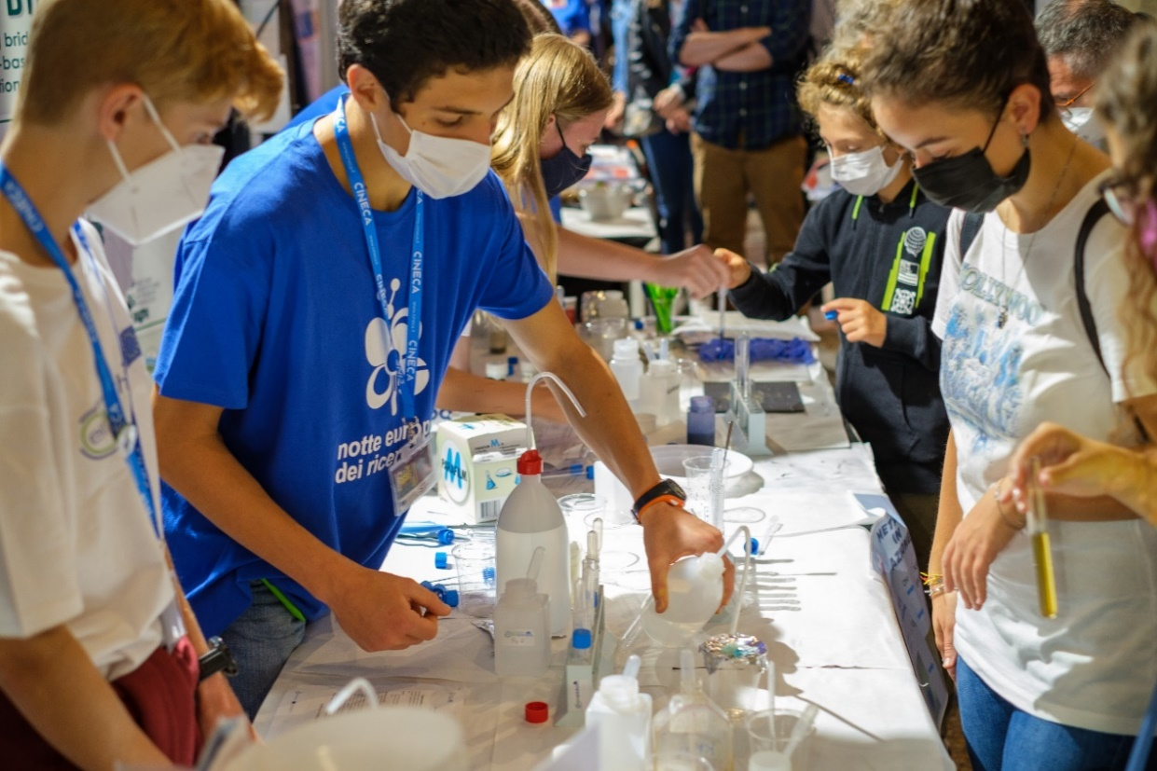
Young RM ambassadors in action during public events
Trained Youngsters become collaborators of expers during public events
i.e. European Researchers’ Night
Bologna 2021 (IT)

Slide 26
VIII European RM@Schools Conference
26 October 2023
Video2
Research Area of CNR, Bologna (IT)

